Slide 1


MOHD KHAJA MOINUDDIN
01-01-2024

Slide 2
Outline
Executive Summary
Introduction
Methodology
Results
Conclusion
Appendix

Slide 3

Executive Summary
Summary of methodologies
Data collection
Data Wrangling
Exploratory data analysis using SQL
Exploratory data analysis for data visualization
Interactive visual analytics with folium
Build an interactive Dashboard with polty Dash
Predictive analysis using Machine learning
Summary of all results
Exploratory Data Analysis Results
Interactive Analytics Demo In Screenshots
Predictive analysis Results

Slide 4
Introduction
Project background and context
Space X deals with the defense contractor and satelite communications company.. It advertises Falcon 9 rocket launches on its website with a cost of 62 million dollars other providers cost upward of 165 million dollars each. much of the savings is because Space X can reuse the first stage.Therefore if we can determine if th first stage will land we can determine the cost of a launch.After the first stage we have achived we done the maximum part of the mission because it is main difficult part to reuse it.
Problems you want to find answers
How do variable such as paylod mass,launch site,number of flights and orbits affect the success rate of the first stage landing
Does the rate of successful landing increase or decrease over the year of period
What is the best algorithm to gain the maximum success of the project

Slide 5

Section 1

Slide 6
Methodology
Executive Summary
Data collection methodology:
-> using Space X Rest API
-> using Web Scrapping from Wikipedia
Perform data wrangling
-> Filtering the data
-> Dealing with missing values
-> Using Encoding to prepare the data to a binary classification
Perform exploratory data analysis (EDA) using visualization and SQL
Perform interactive visual analytics using Folium and Plotly Dash
Perform predictive analysis using classification model
-> Building, tuning and evaluation of classification models to ensure the best results

Slide 7
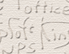
Data Collection
To achived the Data Collection process we have to follow two process involved a combination of API requrests from SPACEX REST API and WEB SCRAPING data in SpaceX.
Data Columns are obtained by using SpaceX Rest API :
FlightNumber, Date, BoosterVersion, PayloadMass, Orbit, LaunchSite, Outcomes, Flights, GridFins, Reused, Legs, LandingPad, Block, ReusedCount, Serial, Longitude, Lattitude
Data Columns are obtained by using Wikipedia Web Scraping :
Flight NO, Launch site, Payload, PayloadMass, Orbit, Customer, Launch Outcome, Version Booster, Booster landing, Date, Time.

Slide 8

Data Collection – SpaceX API
Make a request to get rocket launch data using response.status_code
Decode the response content as a JSON using .json() then convert the json into a dataframe using .json_normaliza()
Constructing data we have obtained into a dictionary
Creating a Pandas DataFrame from the Dictionary
Filtering the Data only include Falcon 9 Launches
Replacing missing value of Payload Mass column with calculated .Mean() for this column
Exporting the data to csv
GIT HUB LINK : https://github.com/khajabadshah/Applied-data-science-capstone/blob/2280be43e87358179499e5307441f98e6cd75ecd/Data%20Collection%20API.ipynb

Slide 9
Data Collection - Scraping
Requesting Falcon 9 launch data from Wikipedia using Get Response from HTML
Creating a Beautiful Soup Object from HTML
Extracting all column names from the HTML table header
Collecting the data by parsing HTML tables
Constructing data we have obtained into a dictionary
Creating a dataframe from the dictionary
Exporting the data to CSV
GIT HUB LINK : https://github.com/khajabadshah/Applied-data-science-capstone/blob/main/aData%20Collection%20With%20Webscraping.ipynb

Slide 10
Perform exploratory Data Analysis and determine training labels
Calculate the number of launches on each site
Calculate the number and occurrence of each orbit
Calculate the number and occurrence of mission outcome per orbit type
Create a landing outcomes label from outcome column
Exporting the data to CSV
Data Wrangling
The data set contained various mission outcomes that were converted into Training Labels with 1 meaning the booster sucessfully landed and 0 meaning booster was unsuccessfully in landing. following landing scenarios were comsidered to create labels:
TRUE ocean means the mission outcome was successfully landed to a specific region of the ocean
FALSE ocean means the mission outcome was unsuccessfully landed to a specific region of the ocean
RTLS means the mission outcome was successfully landed to a ground pad
FALSE RTLS means the mission outcome was unsuccessfully landed to a ground pad
TRUE ASDS means the mission outcome was successfully landed to a drone ship
FALSE ASDS means the mission outcome was unsuccessfully landed to a drone ship
GIT HUB LINK : https://github.com/khajabadshah/Applied-data-science-capstone/blob/main/Data%20Wrangling.ipynb

Slide 11
EDA with Data Visualization
1) Scatter plots show the relationship between variablea. If a relationship exists, they could be used in machine learning model.
Relationship between Flight Number and Launch Site
Relationship between Payload and Launch Site
2) Bar charts show comparisos among discrete categories. The goal is to show the relatioship between the specifc categories being compared and a measured value.
Relationship between success rate of each orbit type
3) Line charts show trends in data over time (time series)
Average launch success yearly trend
GIT HUB LINK : https://github.com/khajabadshah/Applied-data-science-capstone/blob/main/EDA%20with%20Data%20Visualization.ipynb

Slide 12
EDA with SQL
To better understand SpaceX data set, following SQL queries/operations were performed on an IBM DB2 cloud instance:
Display the names of the unique launch sites in the space mission
Display 5 records where launch sites begin with the string 'CCA'
Display the total payload mass carried by boosters launched by NASA (CRS)
Display average payload mass carried by booster version F9 v1.1
List the date when the first successful landing outcome in ground pad was achieved.
List the names of the boosters which have success in drone ship and have payload mass greater than 4000 but less than 6000
List the total number of successful and failure mission outcomes
List the names of the booster_versions which have carried the maximum payload mass. Use a subquery
List the failed landing_outcomes in drone ship, their booster versions, and launch site names for in year 2015
Rank the count of landing outcomes (such as Failure (drone ship) or Success (ground pad)) between the date 2010-06-04 and 2017-03-20, in descending order
GIT HUB LINK : https://github.com/khajabadshah/Applied-data-science-capstone/blob/main/EDA%20with%20SQL.ipynb

Slide 13
Build an Interactive Map with Folium
• An interactive map offers a dynamic way to visualize and analyze launch site dara. Folium interactive map helps analyze geospatial data to perform more interactive visual analytics and better understand factors such location and proximity of launch sites that impact launch success rate.
• Mark all launch sites on the map. This allowed to visually see the launch sites on the map.
-> Added Marker with Circle, Popup Label and Text Label of NASA Johnson Space Center using its latitude and longitude coordinates as a start location.
-> Added Markers with Circle, Popup label andtext Label of all Launch Sites using their latitude and longitude coordinates to show their geographical locations and proximity to Equator and coasts.
• Coloured Markers of the launch outcomes for each Launch Site:
-> Added coloured Markers of success(Green) and failed (Red) launches using Marker Cluster to identify which launch sites have relatively high success rates.
• Distances between a Launch Site to its proximities :
-> Added coloured Lines to show distances between the Launch Site KSC LC-39A (as an example) and its proximities like Railway, Highway, Coastine and Closest City.
GIT HUB LINK : https://github.com/khajabadshah/Applied-data-science-capstone/blob/main/Interactive%20Visual%20Analytics%20with%20Folium.ipynb

Slide 14
Build a Dashboard with Plotly Dash
Launch Sites Dropdown List:
- Added a dropdown list to enable Launch Site selection.
Pie Chart showing Success Launches (All Sites/Certain Site):
- Added a pie chart to show the total successful launches count for all sites and the Success vs. Failed counts for the site, if a specific Launch Site was selected.
Slider of Payload Mass Range:
- Added a slider to select Payload range.
Scatter Chart of Payload Mass vs. Success Rate for the different Booster Versions:
- Added a scatter chart to show the correlation between Payload and Launch Success.
GIT HUB LINK : https://github.com/khajabadshah/Applied-data-science-capstone/blob/main/Dashboard%20with%20Ploty%20Dash.py

Slide 15
Predictive Analysis (Classification)
Predictive analysis (Classification)
Creating a NumPy array from the column "Class" in data
Standardizing the data with StandardScaler, then fitting and transforming it
Splitting the data into training and testing sets with train_test_split function
Creating a GridSearchCV object with cv = 10 to find the best parameters
Applying GridSearchCV on LogReg, SVM, Decision Tree, and KNN models
Calculating the accuracy on the test data using the method.score() for all models
Examining the confusion matrix for all models
Finding the method performs best by examining the Jaccard_score and F1_score metrics
GIT HUB LINK : https://github.com/khajabadshah/Applied-data-science-capstone/blob/main/Machine%20Learning%20Prediction.ipynb

Slide 16

Results
Exploratory data analysis results
Interactive analytics demo in screenshots
Predictive analysis results

Slide 17

Section 2

Slide 18

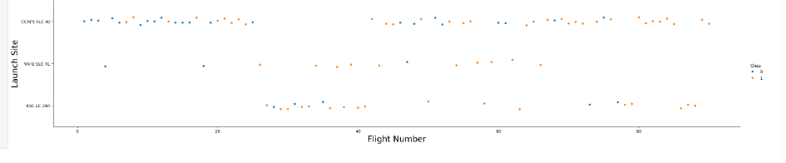
Flight Number vs. Launch Site
• The earliest flights all failed while the latest flights all succeeded.
• The CCAFS SLC 40 launch site has about a half of all launches.
• VAFB SLC 4E and KSC LC 39A have higher success rates.
• It can be assumed that each new launch has a higher rate of success.

Slide 19
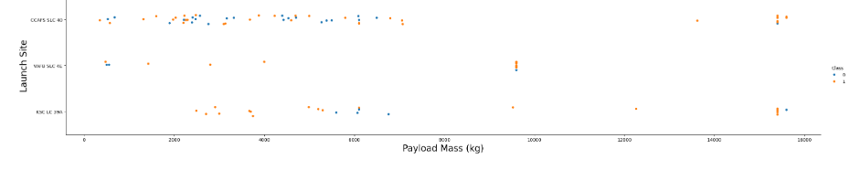
Payload vs. Launch Site
Explanation:
• For every launch site the higher the payload mass, the higher the success rate.
• Most of the launches with payload mass over 7000 kg were successful.
• KSC LC 39A has a 100% success rate for payload mass under 5500 kg too.

Slide 20
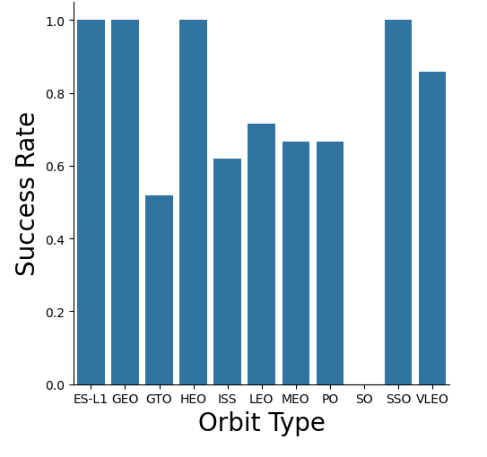
Success Rate vs. Orbit Type
Explanation:
• Orbits with 100% success rate: -
ES-L1, GEO, HEO, SSO
• Orbits with 0% success rate:
- SO
• Orbits with success rate between 50% and 85%:
- GTO, ISS, LEO, MEO, PO

Slide 21
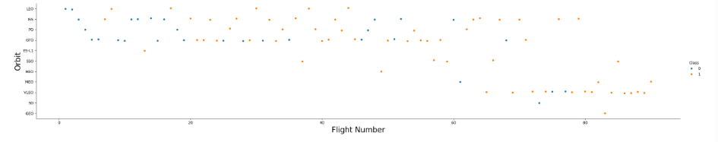
Flight Number vs. Orbit Type
Explanation:
• In the LEO orbit the Success appears related to the number of flights; on the other hand, there seems to be no relationship between flight number when in GTO orbit.

Slide 22
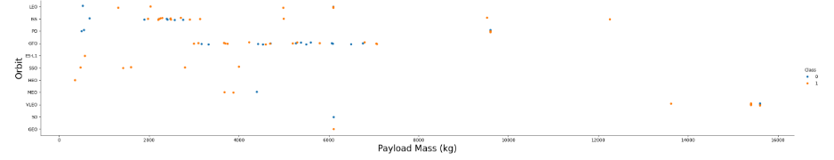
Payload vs. Orbit Type
Explanation:
• Heavy payloads have a negative influence on GTO orbits and positive on GTO and Polar LEO (ISS) orbits.

Slide 23
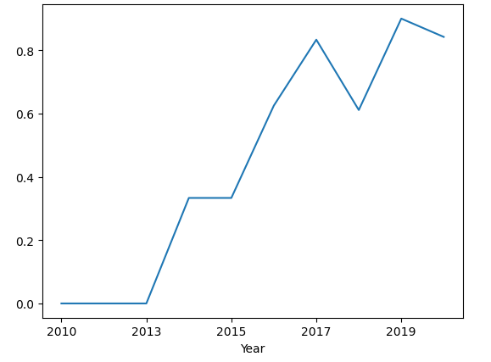
Launch Success Yearly Trend
Explanation:
• The success rate since 2013 kept increasing till 2019.

Slide 24
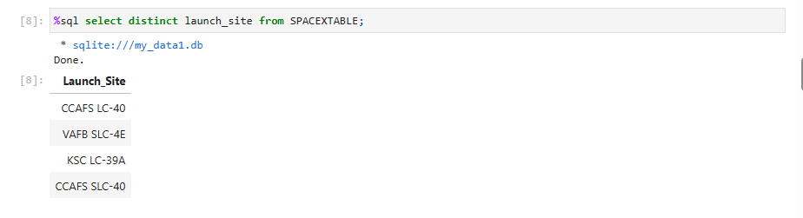
All Launch Site Names
Explanation:
• Displaying the names of the unique launch sites in the space mission.

Slide 25
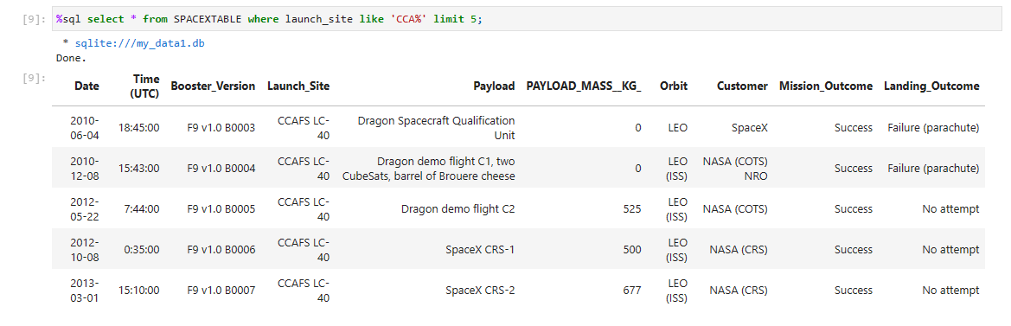
Launch Site Names Begin with 'CCA'
Explanation:
• Displaying 5 records where launch sites begin with the string 'CCA'.

Slide 26
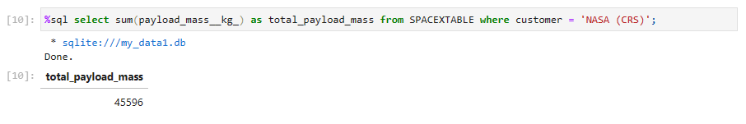
Total Payload Mass
Explanation:
• Displaying the total payload mass carried by boosters launched by NASA (CRS).

Slide 27
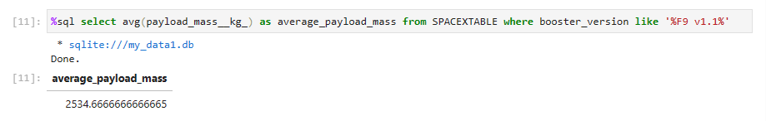
Average Payload Mass by F9 v1.1
Explanation:
• Displaying average payload mass carried by booster version F9 v1.1.

Slide 28
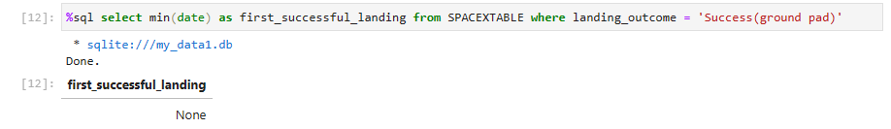
First Successful Ground Landing Date
Explanation:
• Listing the date when the first successful landing outcome in ground pad was achieved.

Slide 29
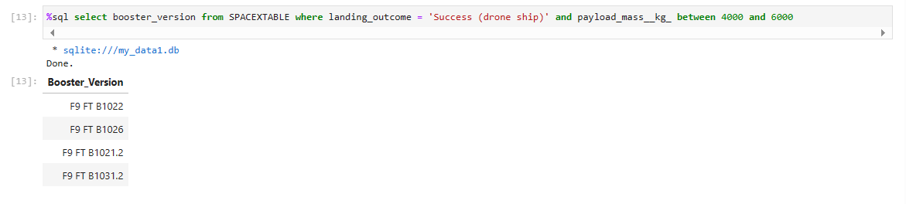
Successful Drone Ship Landing with Payload between 4000 and 6000
Explanation:
• Listing the names of the boosters which have success in drone ship and have payload mass greater than 4000 but less than 6000.

Slide 30
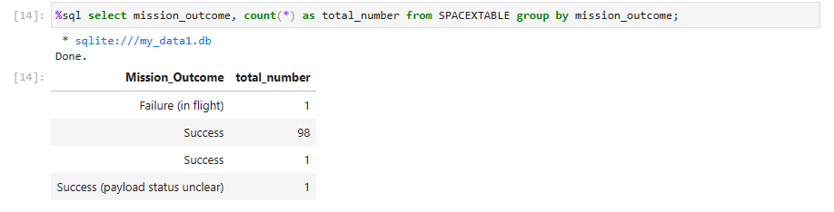
Total Number of Successful and Failure Mission Outcomes
Explanation:
• Listing the total number of successful and failure mission outcomes.

Slide 31
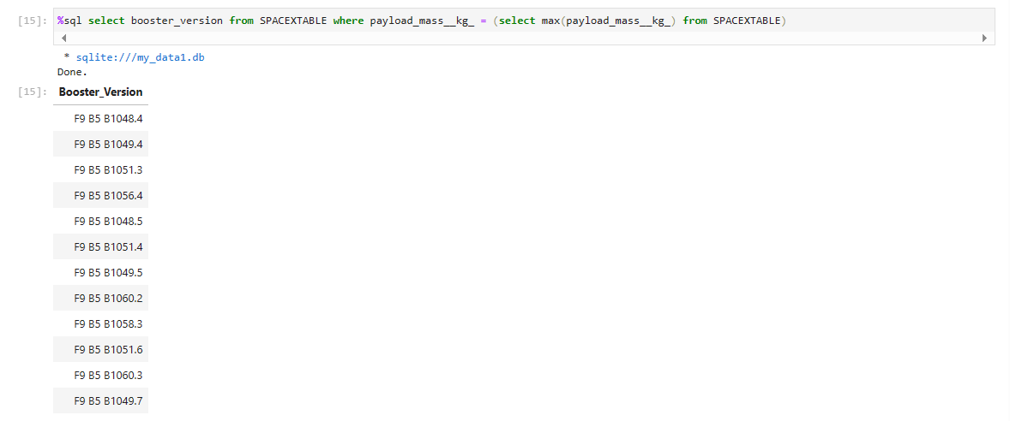
Boosters Carried Maximum Payload
Explanation:
• Listing the names of the booster versions which have carried the maximum payload mass.

Slide 32
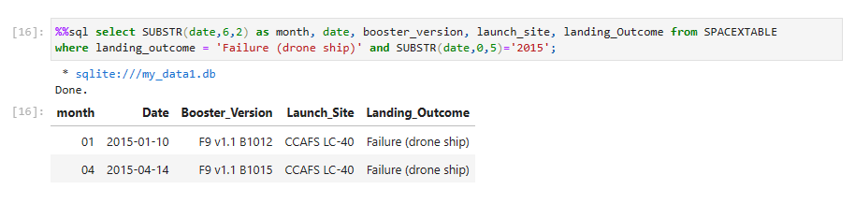
2015 Launch Records
Explanation:
• Listing the failed landing outcomes in drone ship, their booster versions and launch site names for the months in year 2015.

Slide 33
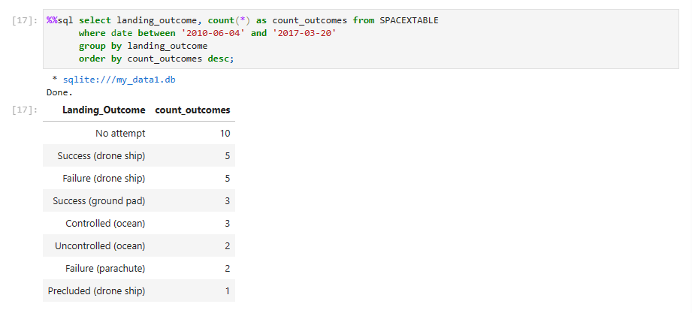
Rank Landing Outcomes Between 2010-06-04 and 2017-03-20
Explanation:
• Ranking the count of landing outcomes (such as Failure (drone ship) or Success (ground pad)) between the date 2010-06-04 and 2017-03-20 in descending order.

Slide 34

Section 3

Slide 35
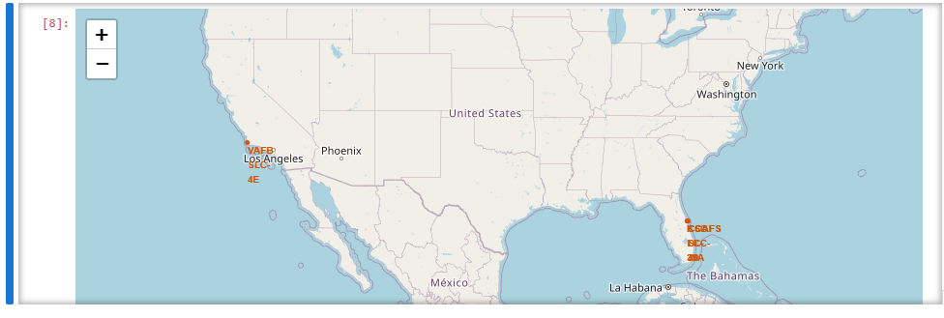
Launch site’s location on Global Map
• VAFB SLC-4E is situated near the western coastline, while KSC LC-39A, CCAFLC-40, and CCAFSLC-40 are positioned along the eastern coastline.
• Upon zooming in, it seems both CCAFLC-40 and CCAFSLC-40 are situated in very close proximity to each other.

Slide 36
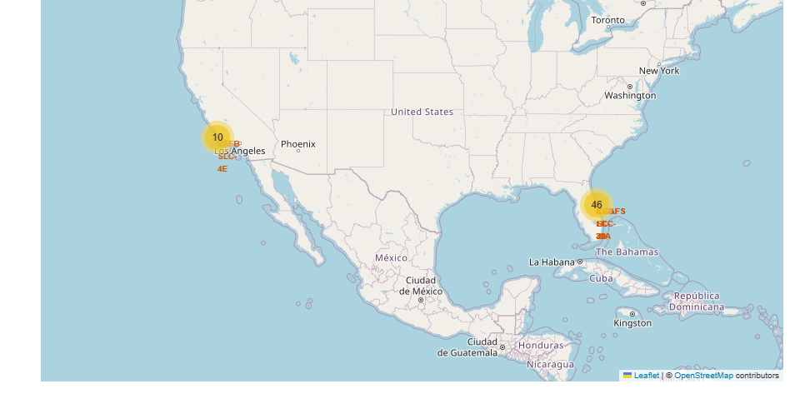
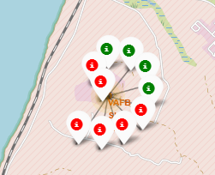
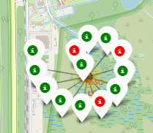
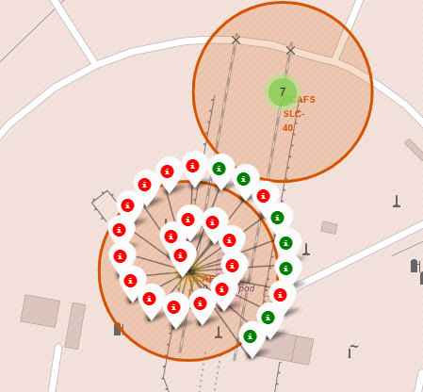
Success/Failed Launches For Launche sites
Explanation:
• From the colour-labeled markers we should be able to easily identify which launch sites have relatively high success rates.
- Green Marker = Successful Launch
- Red Marker = Failed Launch
Launch Site KSC LC-39A has a very high Success Rate.

Slide 37
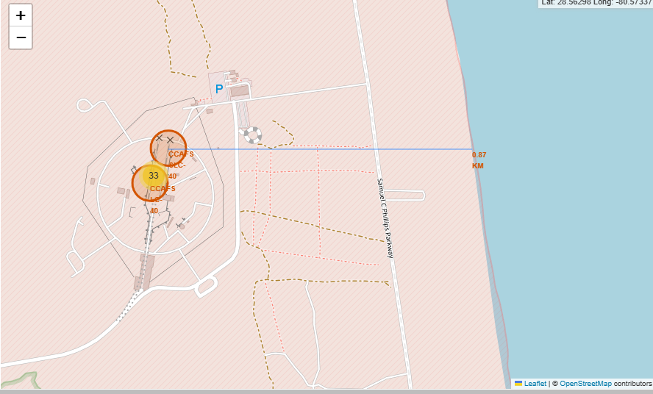
Proximity of Launche Sites to Other Areas
•These figures show a PolyLine between CCAFSLC-40 to the selected coastline point, etc.

Slide 38

Section 4

Slide 39
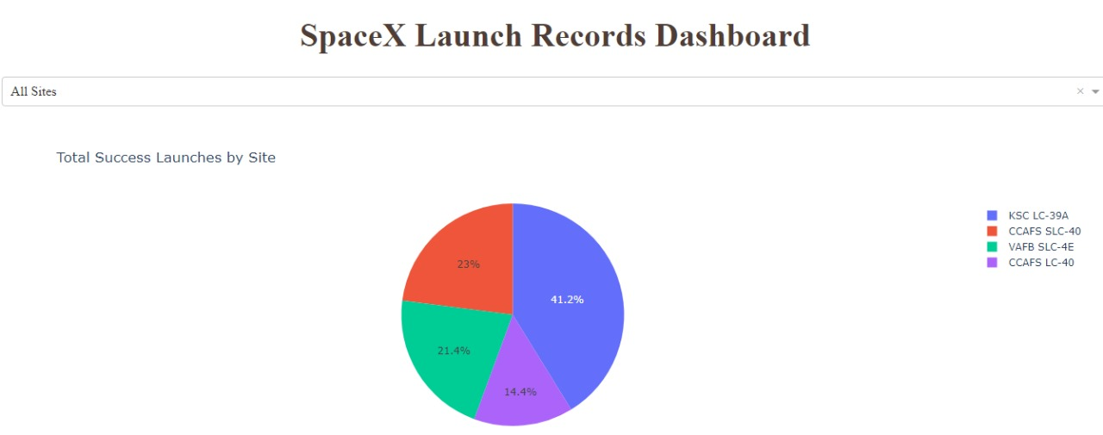
Launch success count for all sites
Explanation:
• The chart clearly shows that from all the sites, KSC LC-39A has the most successful launches.

Slide 40
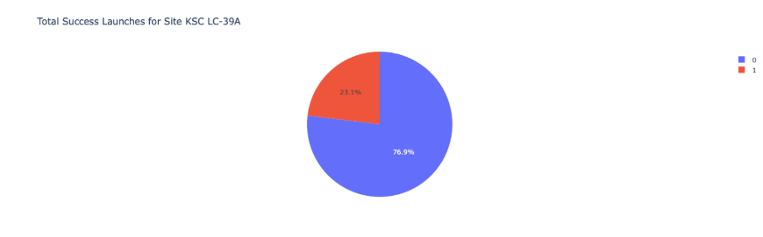
Launch site with highest launch success ratio
Explanation:
• KSC LC-39A has the highest launch success rate (76.9%) with 10 successful and only 3 failed landings.

Slide 41
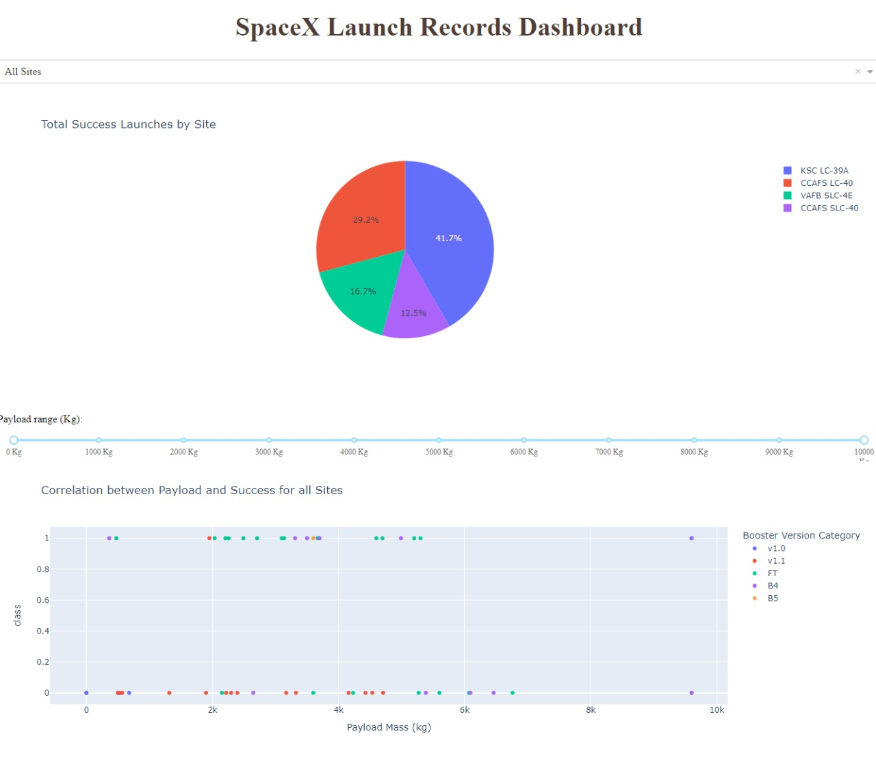
Payload Mass vs. Launch Outcome for all sites
Explanation:
• The charts show that payloads between 2000 and 5500 kg have the highest success rate.

Slide 42

Section 5

Slide 43
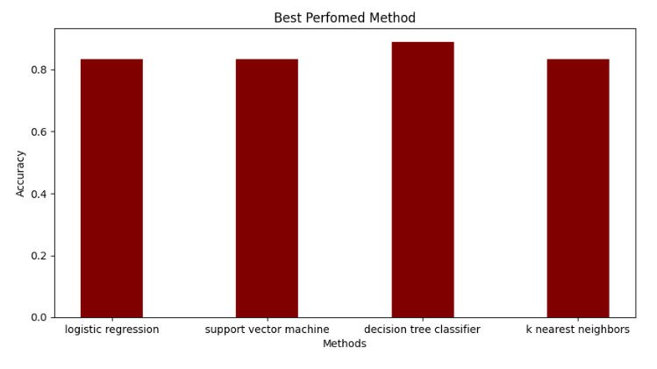
Classification Accuracy
Decision Tree model achieved the highest accuracy at 88 %, while the SVM performs the best in terms of Area Under the Curve at 0.96 (not shown).

Slide 44
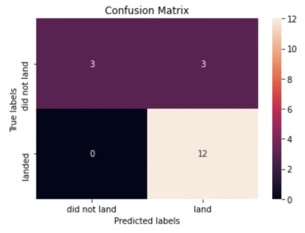
Confusion Matrix
Explanation:
• Examining the confusion matrix, we see that logistic regression can distinguish between the different classes. We see that the major problem is false positives.

Slide 45
Conclusions
→ Decision Tree Model is the best algorithm for this dataset
• Launches with a low payload mass show better results than launches with a larger payload mass.
• Most of launch sites are in proximity to the Equator line
and all the sites are in very close proximity to the coast.
The success rate of launches increases over the years.
• KSC LC-39A has the highest success rate of the launches from all the sites.
• Orbits ES-L1, GEO, HEO and SSO have 100% success rate.

Slide 46
Appendix
We have created many charts in our project and deals with the bar charts then we create a Dash board.

Slide 47


